Slide 1
5LWF0: FEM for electromagnetic devices
1. Solving magnetic field distributions in electromechanical problems
Dr. ir. D.C.J. Krop, Ir. G. Zuidema
10 February 2023

Slide 2
Outline for the lecture of week 1
General information
Course material
Structure of the course
Recapitulation of Maxwell’s equations
Differential and integral form
Physical interpretation
Solving Boundary Value Problems (BVPs) analytically (1D)
Recapitulation of solving differential equations for a toroidal inductor
Numerical methods for solving BVPs (1D)
Method of weighted residuals
Solving a BVP numerically (1D)

Slide 3

General information

Slide 4
Contact information
Responsible lecturer:
Dr.ir. D.C.J. Krop
 d.c.j.krop@tue.nl  FLX 2.089  5716
Instructor:
Ir. G. Zuidema
 g.zuidema@tue.nl  FLX 2.122  3554
Secretariat EPE:
Mrs. T.M. Swanink
 secretariaat-epe@tue.nl  FLX 2.110  2310

Slide 5

Required teaching material for 5LWF0
Notebook
Finite Element software package:
Altair Flux2D 2022.0.1
Download from Canvas
Software folder
Unzip hwFlux2020.1_win64.7z
The software package FLUX is used under an academic license: commercial use is strictly prohibited!
The license server keeps logs of all FLUX activities!

Slide 6
Connection to other courses
Prior courses 5LWF0 builds on
5EWA0: Electromechanics
Magnetic Equivalent Circuits (MECs)
DC-machines
Induction machines
Synchronous machines
5SWA0: Rotary PM machines
Brushless PM machines (AC and DC)
Winding configurations and saturation
EMF, MMF, flux linkage, inductance, and torque production
dq0-axes decomposition
Follow-up courses
5LWC0: Advanced actuator design
Analytical magnetic field calculation methods for electromagnetic actuators
5LWE0: Control of rotating-field machines
Controlling BLPM machines
Graduation project within the EPE
for electromechanics (5LWF0 required!)

Slide 7
Objectives of 5LWF0
Setting up a 2D electromagnetic problem in the Finite Element Method (FEM) software environment FLUX2D
Discretization aspects, i.e. how to properly discretize (or mesh) the problem in order to obtain a reliable electromagnetic field distribution
Using the ‘overlay’ feature in the FLUX2D FEM package for the analysis/design of electromagnetic devices with focus on BLPM machines
Interpretation of the magnetic field distribution on the performance of a BLPM machine

Slide 8
Exam
Assignment :
Analysis of an electrical machine topology: 5 ECTS
Distributed to the students around the halfway-mark: week 4
Written paper on your design approach and final design (60% , min. grade to pass: 5)
Max. 8 pages and stick to the predefined template
To be handed in 1 week prior to oral exam
Oral exam (40%, min. grade to pass: 5)
Defend your design based on simulation results in combination with physical insight and design constraints
Time-slot based on student-ballot, but not later than 2 weeks after Q4 ends

Slide 9
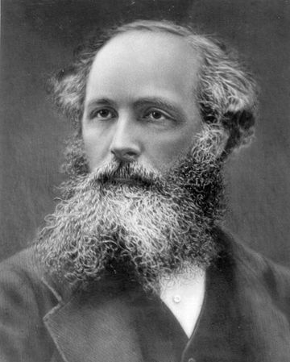
Recapitulation of Maxwell’s equations

Slide 10
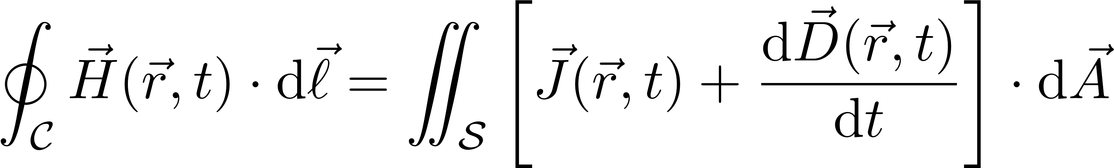
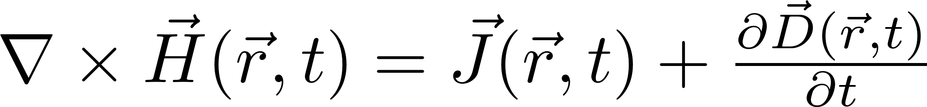
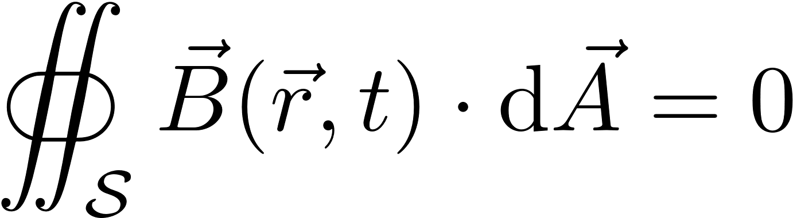
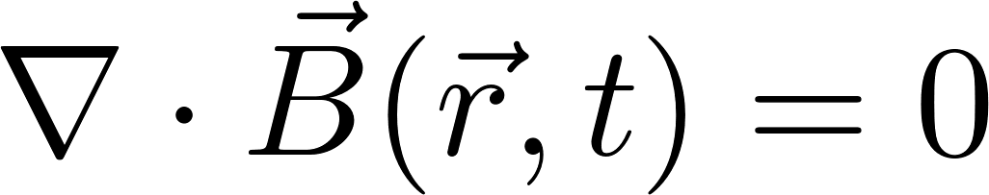
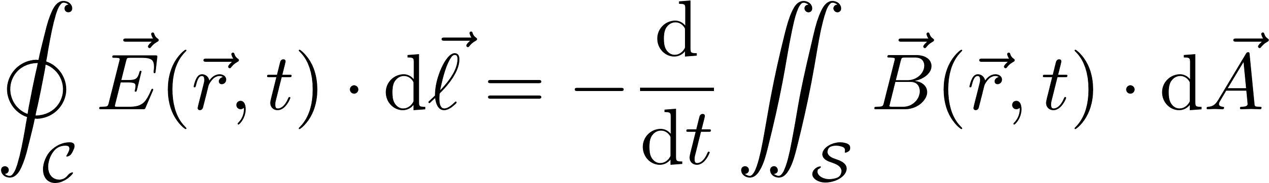
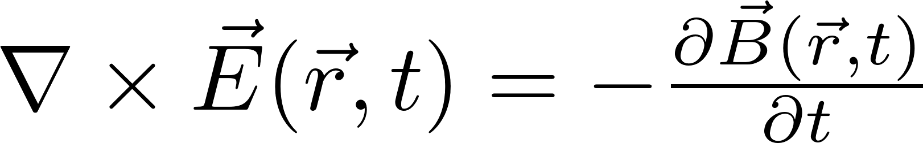
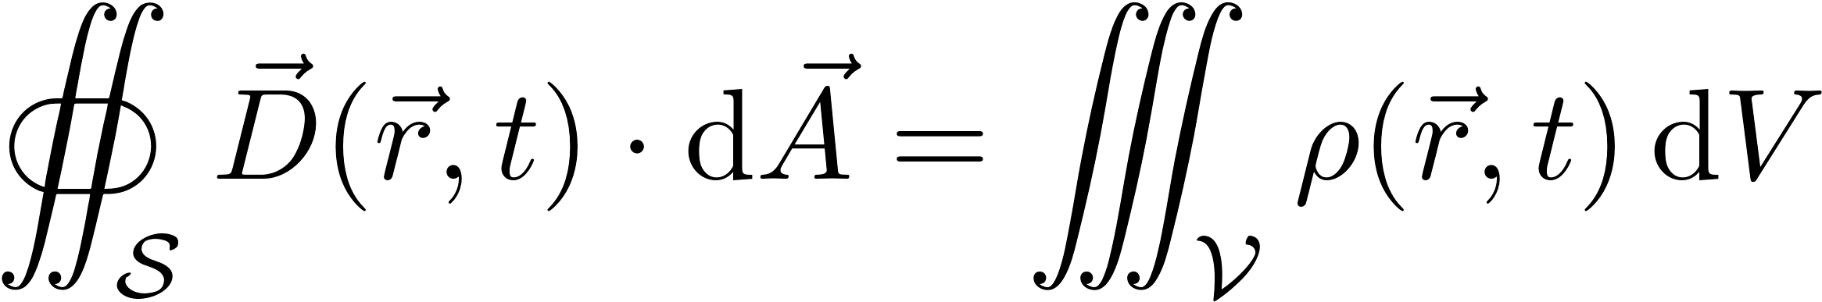
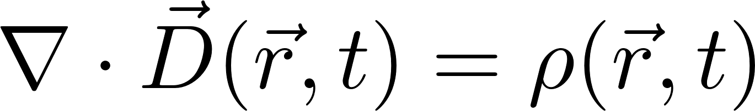
Recapitulation of Maxwell’s equations
 | Integral form | Differential form
Ampère’s law
Gauss’s law (magnetism)
Faraday’s law
Gauss’s law
Classical electromagnetic problems are governed by four coupled partial differential equations (PDE): Maxwell’s equations
Notes:
Explanation of interpretation of the 4 integral equations in words
Ask (explain) nabla operator:
Curl: rotating disk: movement (flow of mass) in plane of disk, around axis perpendicular to the plane of the disk
Divergence: net flow out of a closed surface (or into when <0), e.g. pressurizing a pressure vessel: net mass flow into vessel of fixed volume
Displacement current neglected on account ‘low’ (<1MHz) frequency

Slide 11
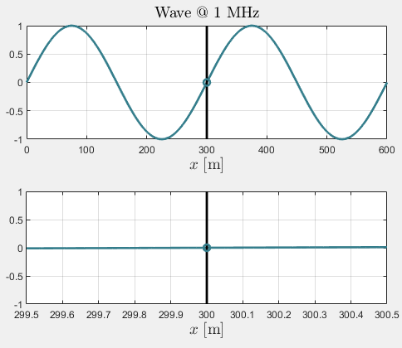
Recapitulation of the quasi-static formulation
Quasi-static formulation for the majority of electromechanical problems
For problems much smaller in size than the wavelength, the displacement term vanishes
Time changes of field quantities within small domains can be considered instantaneous
In electromechanical problems the free-charge, ρ, is often not of interest
Notes:
f=10⁶ Hz and v=c=3*10⁸ m/s
Wavelength: λ=v/f= 300 m
Bottom animation 1m wide problem

Slide 12
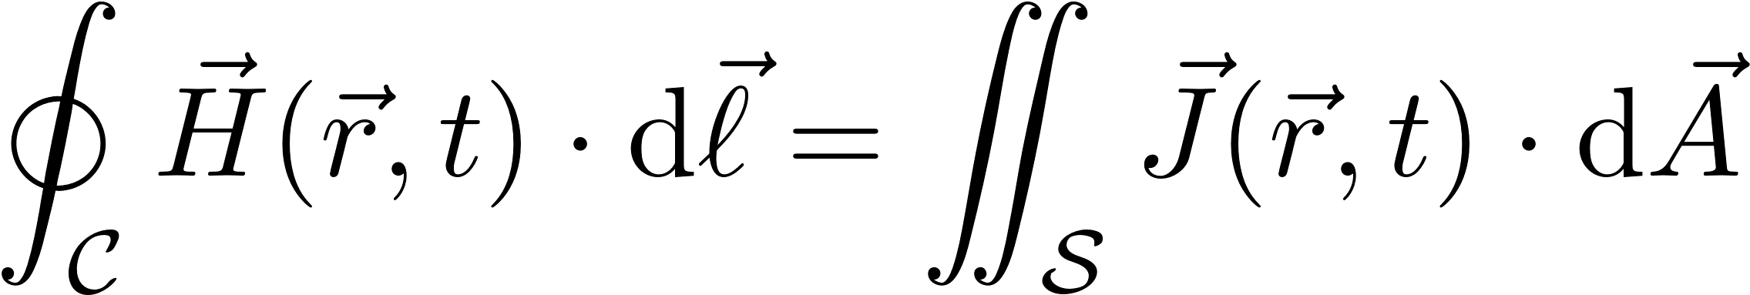
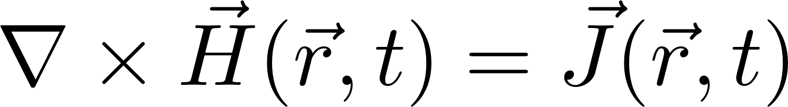
Recapitulation of the quasi-static formulation
 | Integral form | Differential form
Ampère’s law
Gauss’s law (magnetism)
Faraday’s law
Notes:
Field quantities couples via the constitutive relations, i.e. the properties of the medium.

Slide 13
Constitutive relations (material properties)
The four Partial Differential Equations (PDEs) are coupled via the electromagnetic material properties
For isotropic, linear materials the constitutive relations due to materials are
Magnetic
Electric
Of minor
interest in 5LWF0!
H | : magnetic field strength | [A/m]
B | : magnetic flux density | [T]
M₀ | : remanent magnetization | [A/m]
µ₀ | : (magnetic) permeability of vacuum | [H/m]
 | value: µ₀ = 4π·10⁻⁷ H/m
µ_{r} | : relative (magnetic) permeability | [-]
E | : electric field strength | [V/m]
D | : electric flux density | [C/m²]
P | : polarization | [C/m²]
ε₀ | : (electric) permittivity of vacuum | [F/m]
 | value†: ε₀ = µ₀⁻¹c⁻² = 8,854·10⁻¹² F/m
ε_{r} | : relative (electric) permittivity | [-]
† c denotes the speed of light in vacuum, i.e. c = 2.998·10⁸ m/s
Notes:
Quantities in a linear equation: permeabilities and remanent magnetization are constants!

Slide 14
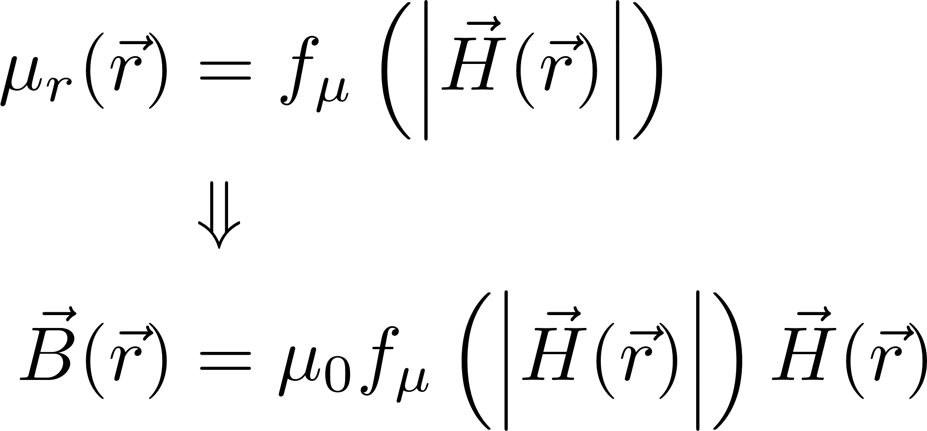
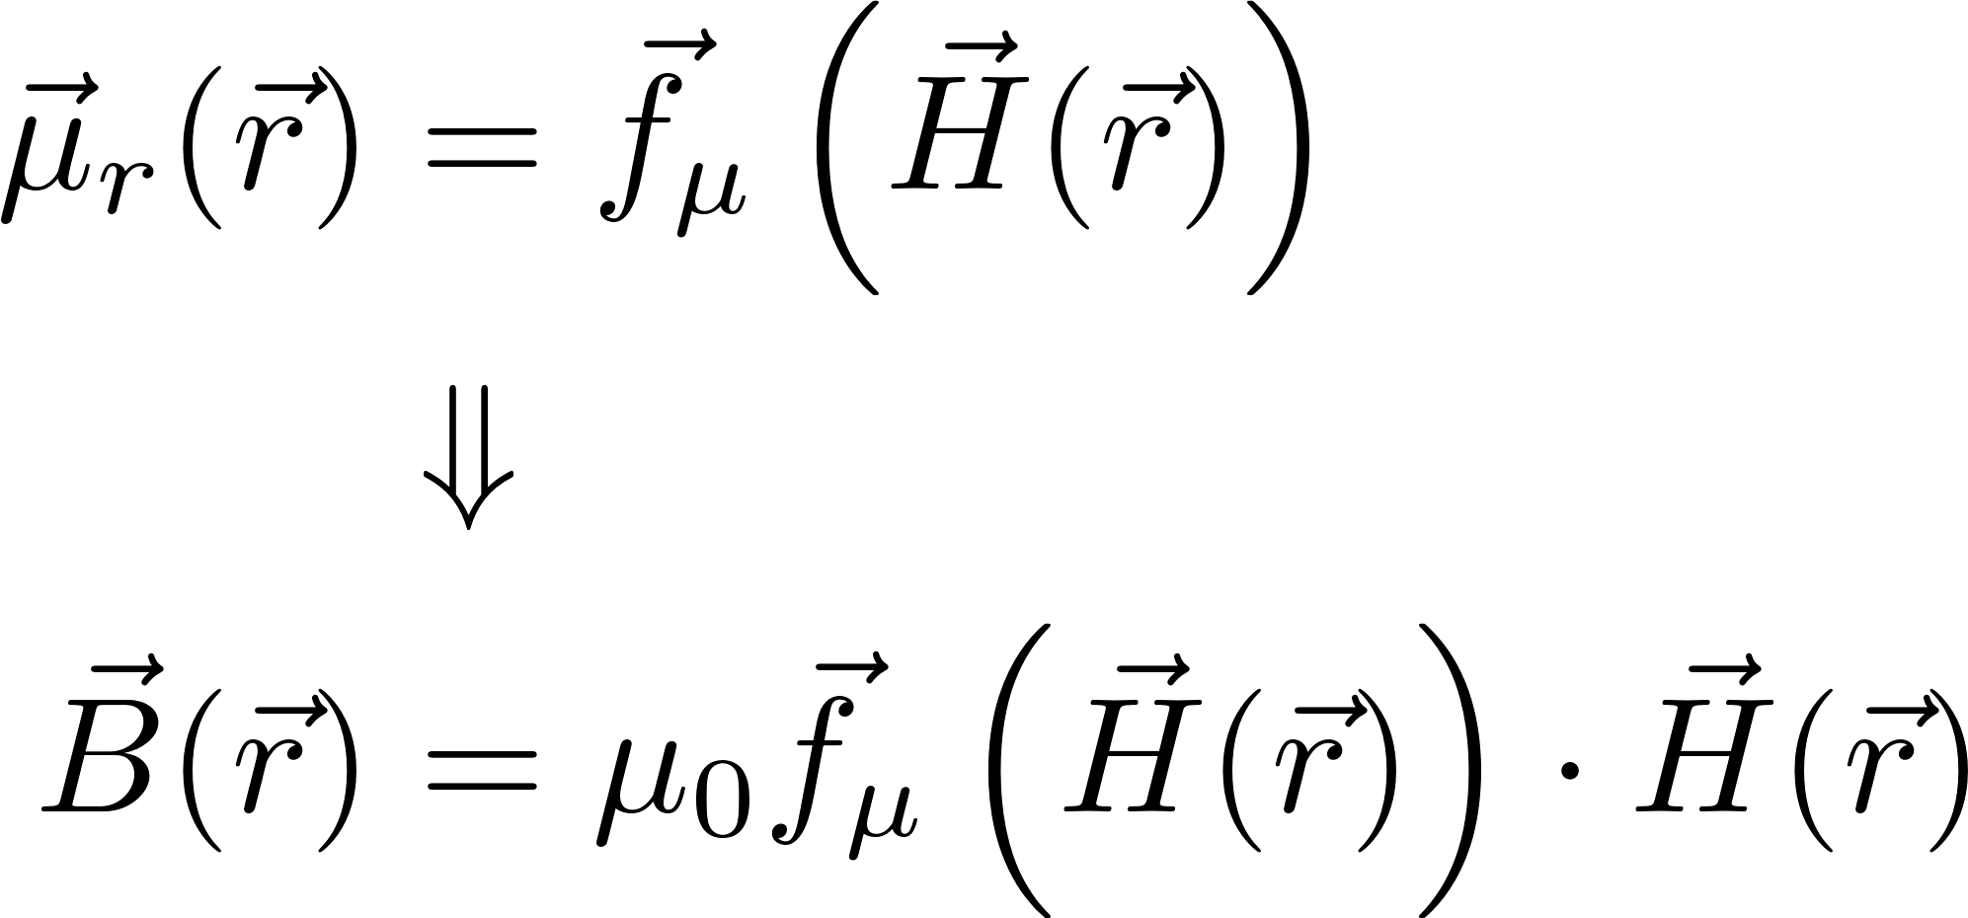
Constitutive relations (material properties)
Hard-magnetic materials: M₀ ≠ 0
Assumed to be linear when utilized properly! (In later lectures more)
Non-linear soft-magnetic materials: M₀ = 0 and µ_{r} (H)
Scalar material properties that depend only on the local magnitude of the fields
Tensor material properties that depend on the local spatial components of the fields
Isotropic
Anisotropic
Of minor
interest in 5LWF0!
Notes:
Anisotropic minor since lamination is a form on intentional anisotropy.

Slide 15
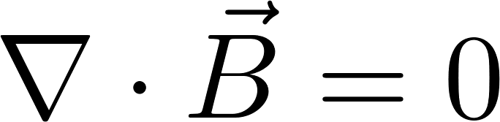
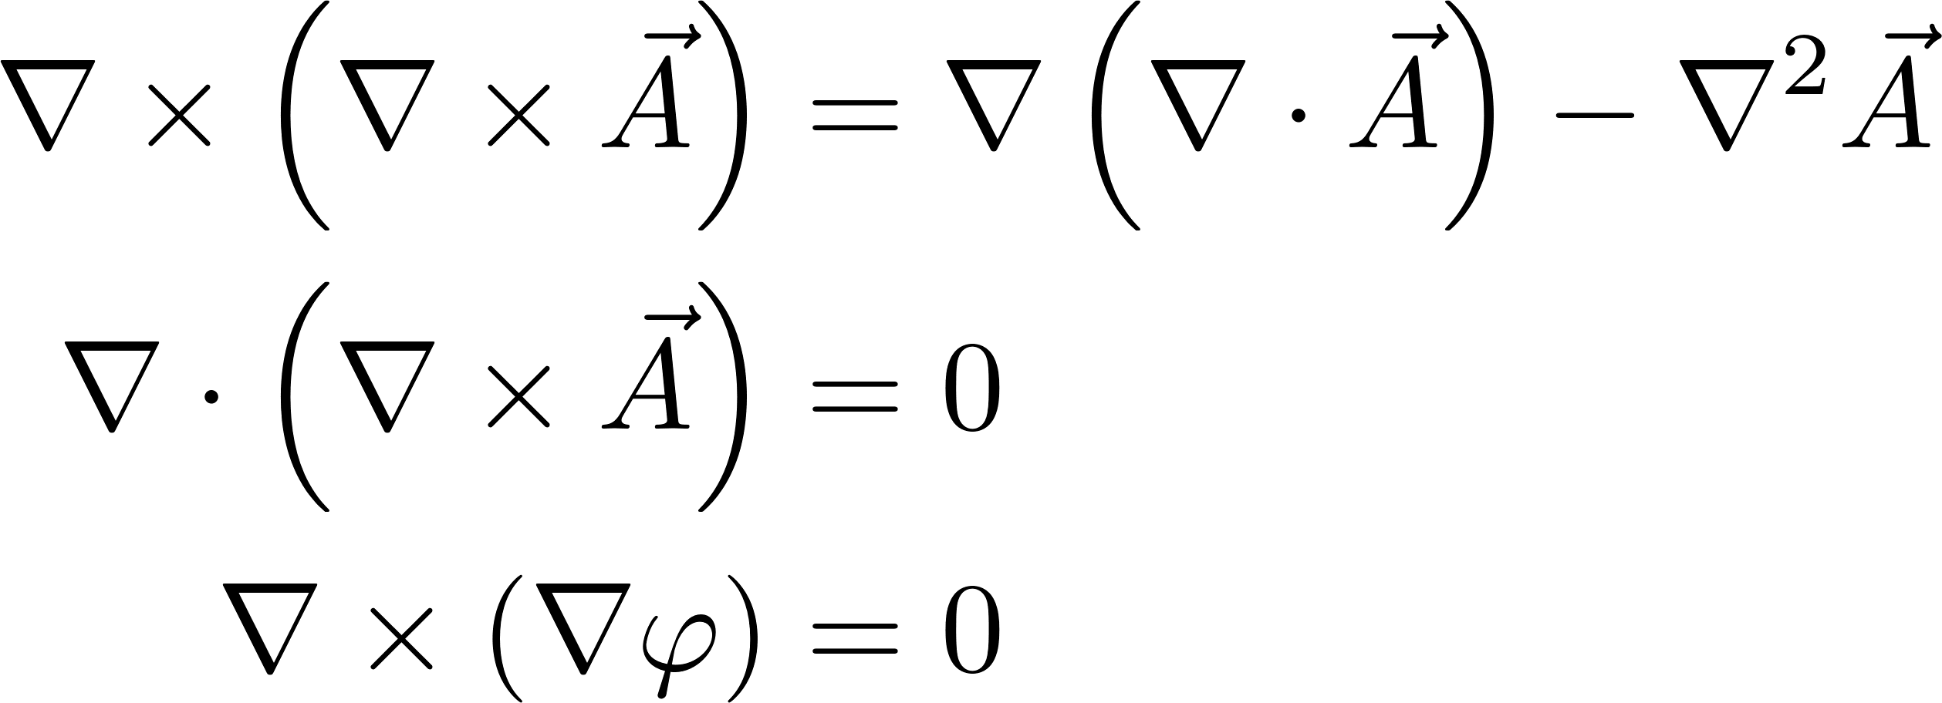
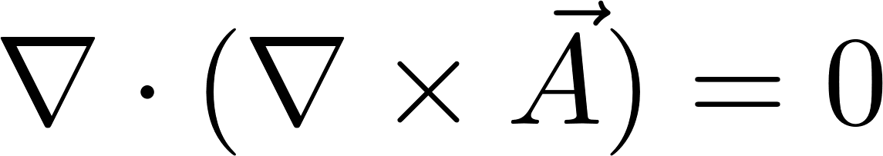
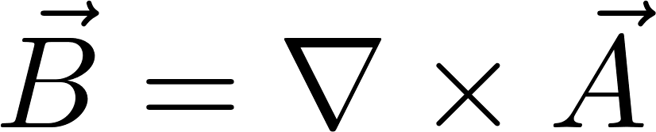
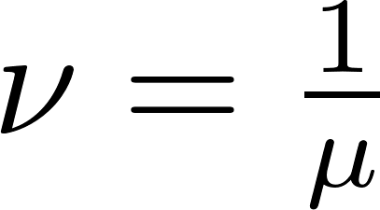
The magnetic vector potential (MVP) for 2D problems
By introducing the MVP the number of PDEs can be reduced
Gauss’s law for magnetism:
Applying the vector identity . Hence,
Reduction of a system of coupled PDEs to a single PDE (where reluctivity ).
2D elliptic PDE
Poisson equation for linear materials:
constant reluctivity
Notes:
MVP is introduced to reduce the number of equations
Gauge fixing:
A_{z} uniquely defined and (solvable) when both its div and curl are determined
Curl is determined, as rot(A_{z} )=B
Divergence can be chosen freely: convenient choice Div(A_{z}) =0

Slide 16
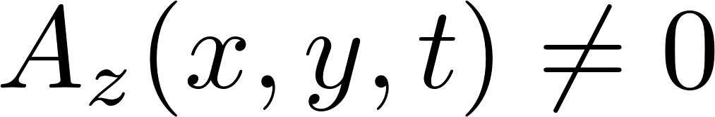
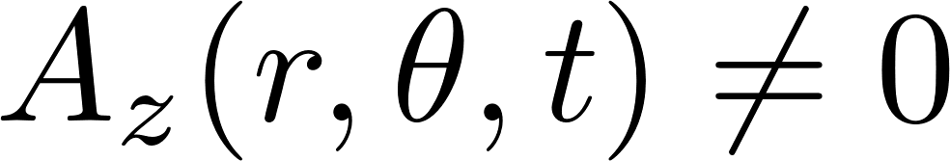
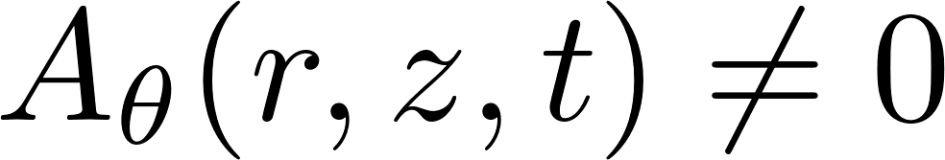
Vector potential in 2D problems
In 2D problems the flux density field is confined to a single plane ➔ The MVP has only one nonzero spatial component as result of the curl operation
2D Cartesian | B confined to the xy-plane
2D polar | B confined to the rθ-plane
2D cylindrical | B confined to the rz-plane
Notes:
Repeat rotating disk example for clarification. Flow in plane of disk, axis of rotation perpendicular to the plane of the disk

Slide 17
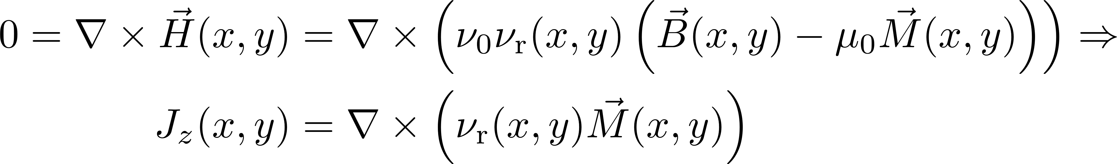
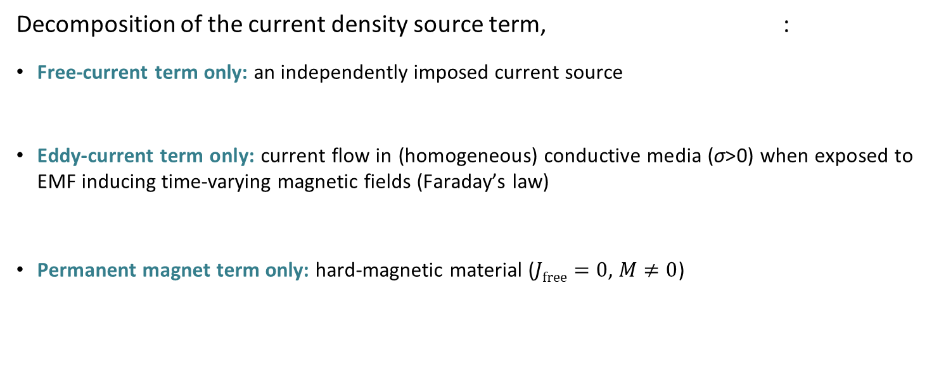
Additional source terms
Decomposition of the current density source term, :
Free-current term only: an independently imposed current source
Eddy-current term only: current flow in (homogeneous) conductive media (σ>0) when exposed to EMF inducing time-varying magnetic fields (Faraday’s law)
Permanent magnet term only: hard-magnetic material ($Jfree=0$, $M≠0$)
Notes:
Eddy term: EMF exists always (Faraday), when in conductive material currents will flow due to EMF
PM term: substitution of material model into Ampère’s law

Slide 18
General PDE for additional source terms (parabolic PDE)
PDE for 2D electromechanical, non-linear problems:
Depending on the physical nature of the problem (or assumptions) terms might vanish
In general, problems consist of a combination of multiple domains of different physical nature
The magnetization term is the only source term that is not defined in the z-direction.
Is this a mathematical violation?
For most practical cases, the PDE cannot be solved analytically, not even for linear materials
What is still missing to uniquely solve this parabolic PDE?

Slide 19
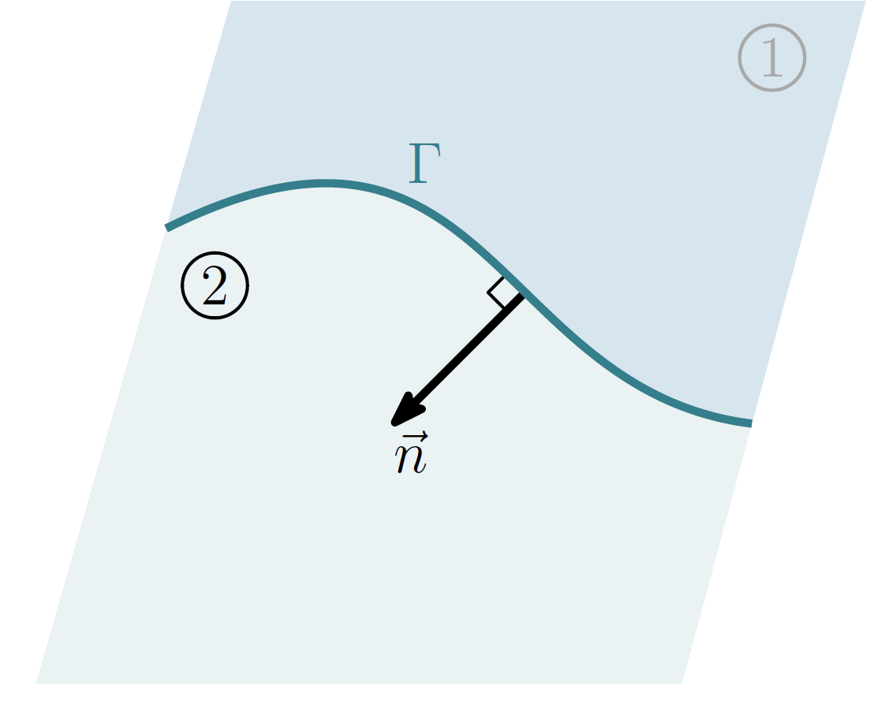
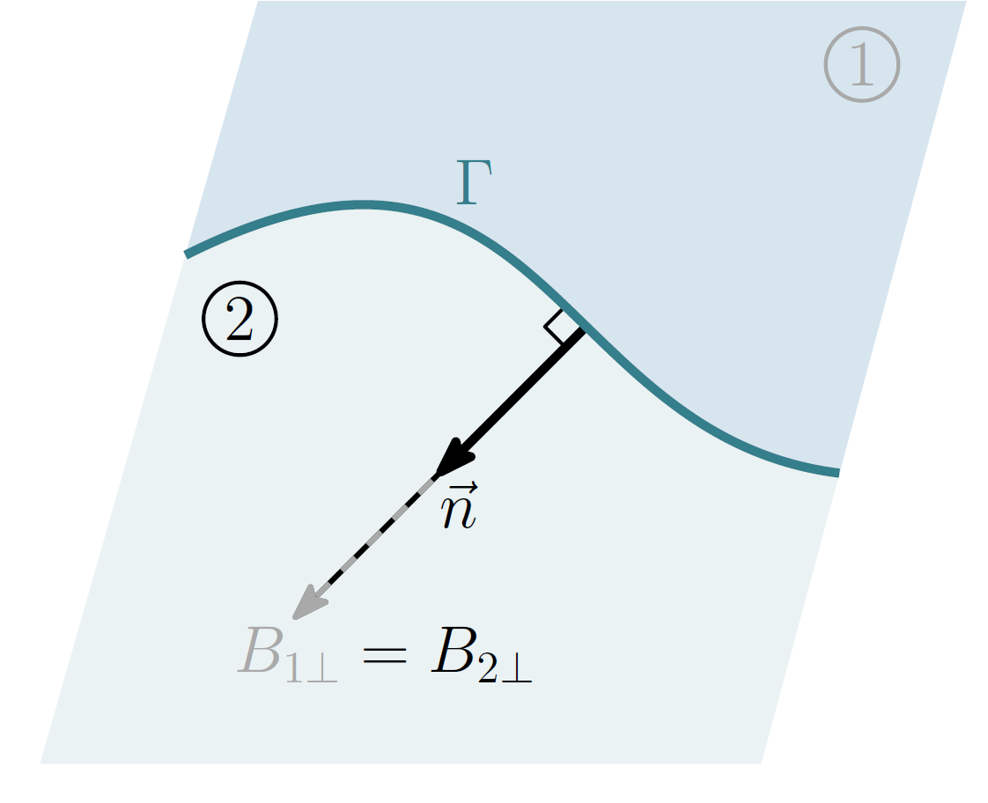
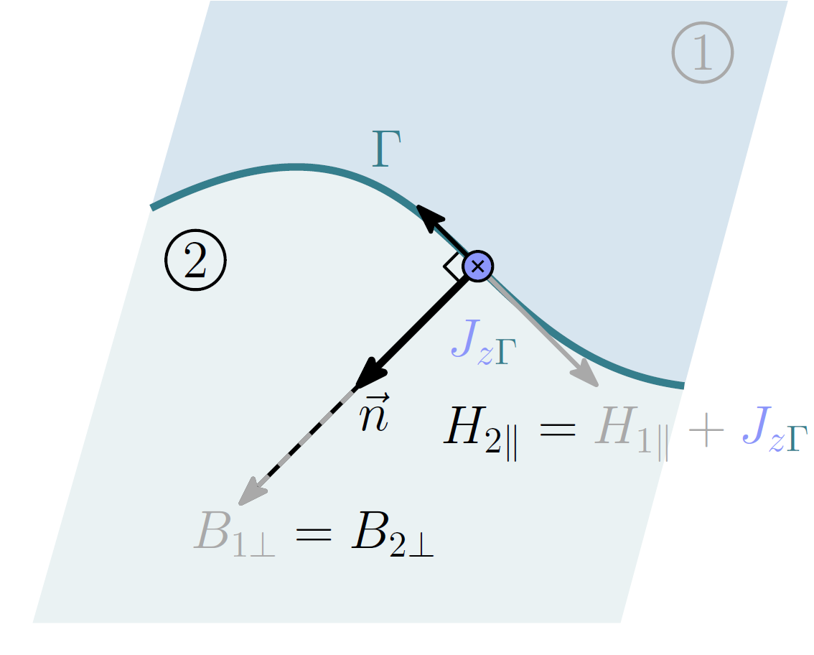
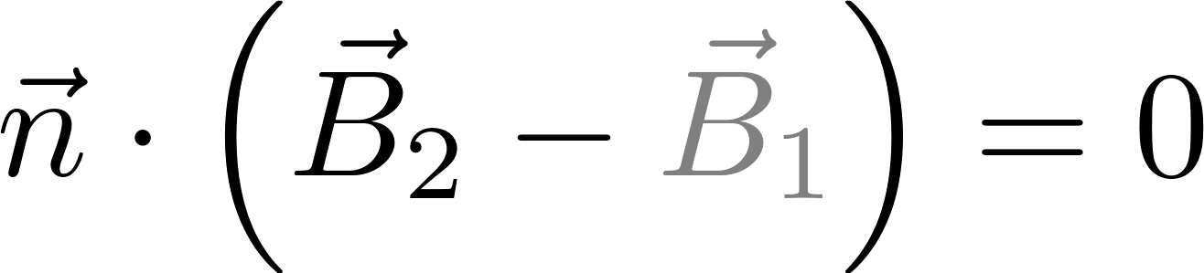

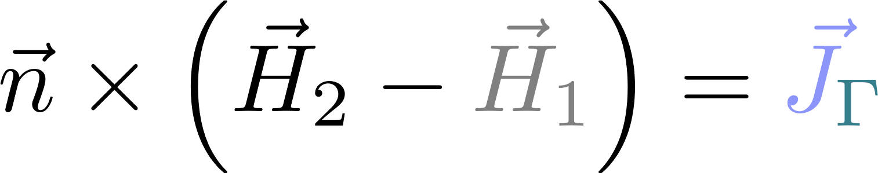
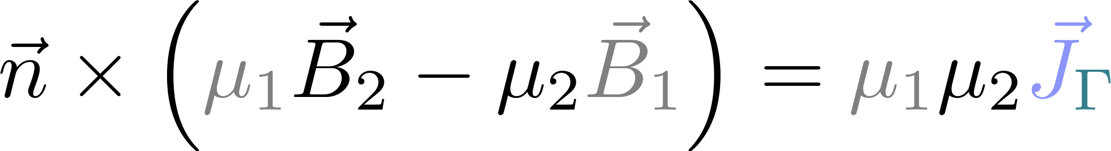
Electromagnetic Boundary Conditions (BC)
Normal BC
The normal flux density components are equal on either side of the boundary, Γ
Tangential BC
The difference in the magnetic field strength between the tangential components is equal to the surface current density on the boundary, Γ
Convention:
normal vector points from 1 into 2
M₀ = 0
Notes:
J is negative in this example!! H₂ point in the opposite direction and therefore J>H₁

Slide 20
Reduced formulations of the PDE
Transient: full PDE solved by time stepping (slow)
Nonlinear materials, Faraday: time-varying sources + movement, PMs can be modeled
Magnetostatic: time-invariant field quantities and sources (fast)
Nonlinear materials, no Faraday: DC sources, no movement, PMs can be modeled
Steady-state AC: frequency domain: complex-valued field quantities and sources (fast)
Linear materials, Faraday: single harmonic AC sources, no movement, no PMs (why?)
Notes:
MS: Dynamical inrush effects (damped-out after t->∞)
Transformer and movement EMF
AC: Harmonic distortion for NL material not taken into consideration

Slide 21

Summary on Maxwell’s equations and the PDE formulation
Basic electromagnetic principles of previous slides should already be (or become) ready knowledge
Quasi-static Maxwell’s equation
Interpretation of field distribution images (no derivation of equations!)
Insight in basic principles of operation of electromechanical devices
Boundary conditions
Placing, assigning and exploiting boundary conditions properly
Formulation of the governing partial differential equation
Selection of the proper solver type in FLUX2D, i.e. advantages vs. limitations
Impact of material assumptions on performance of electromechanical problems
Optimize ‘cost’ of simulation effort

Slide 22
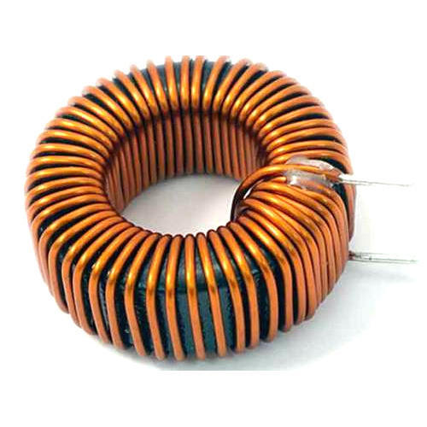
Solving a Boundary Value Problem (BVP) analytically
Notes:
Min: 30-45

Slide 23




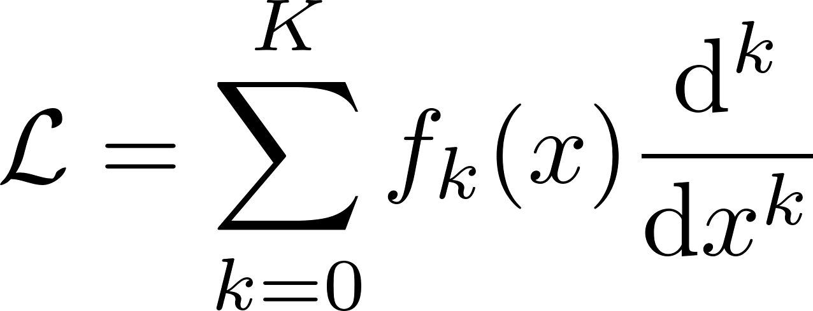
Generic expression of a (1D) differential equation
differential operator
source term
: the quantity/function of interest to be solved, e.g. MVP
: the spatial variable (a scalar or vector depending on the dimensions of the problem)
: the source term
Results in a nonzero particular/inhomogeneous solution of the PDE
: the differential operator contains the expression that acts on :

Slide 24

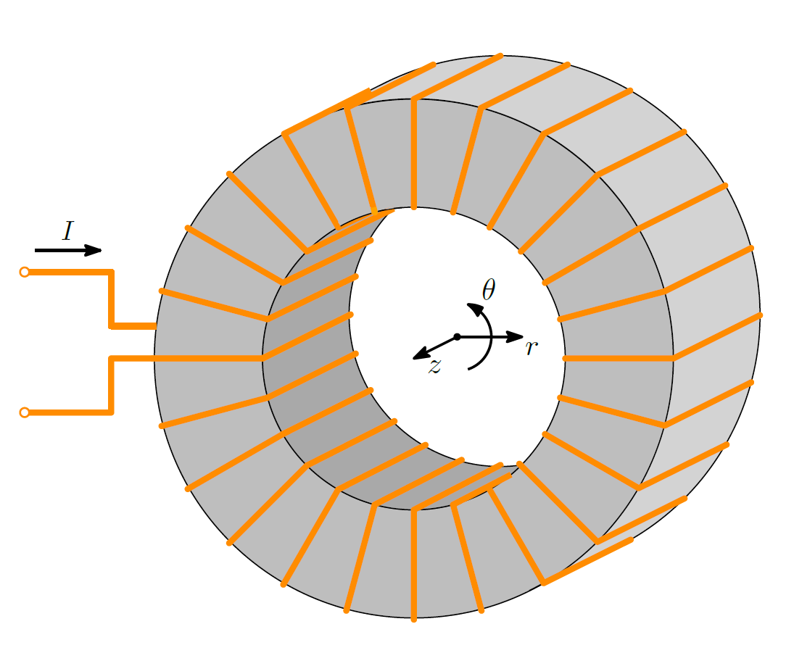
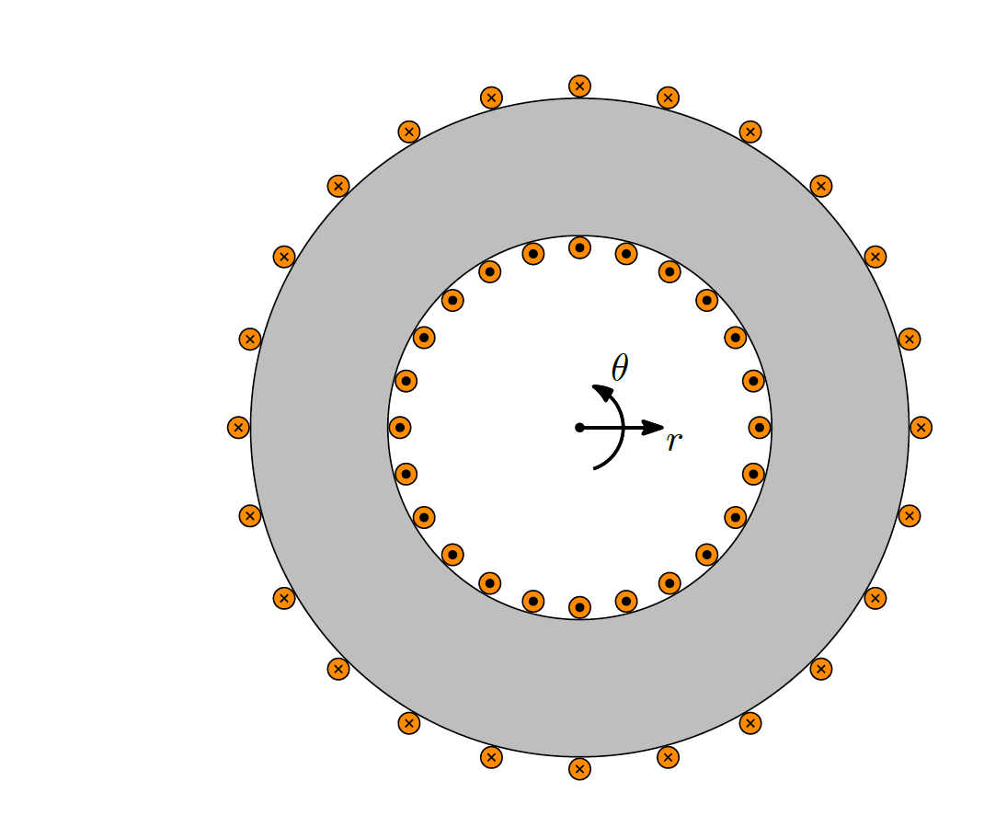
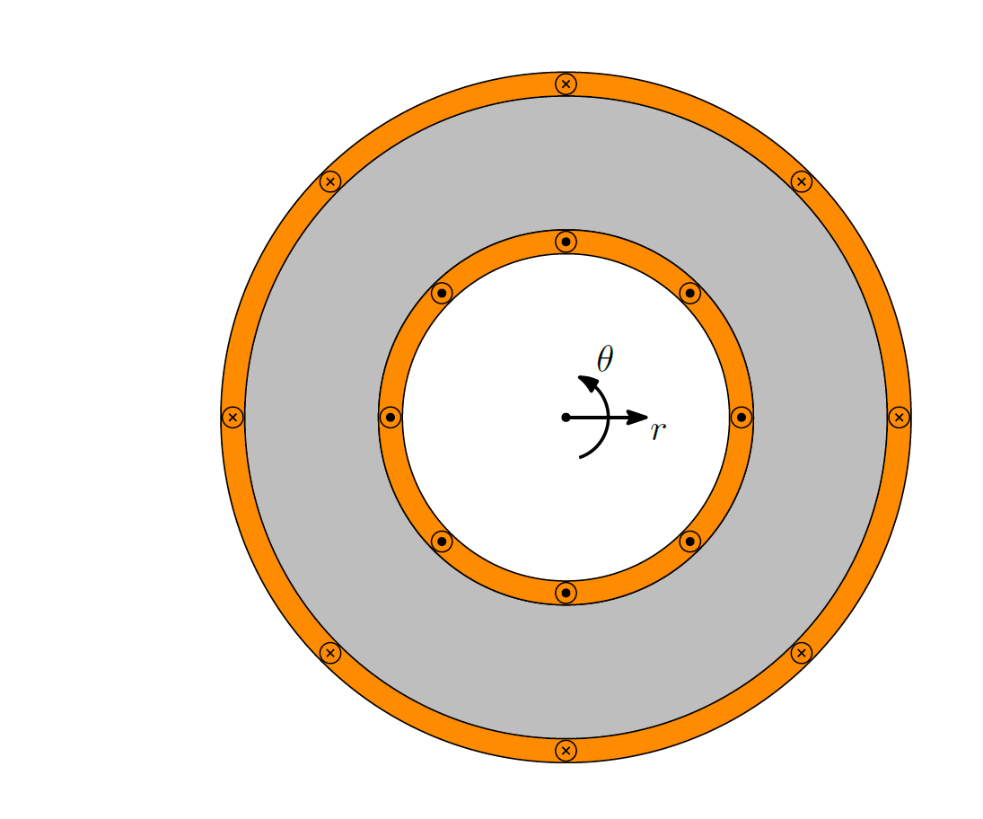
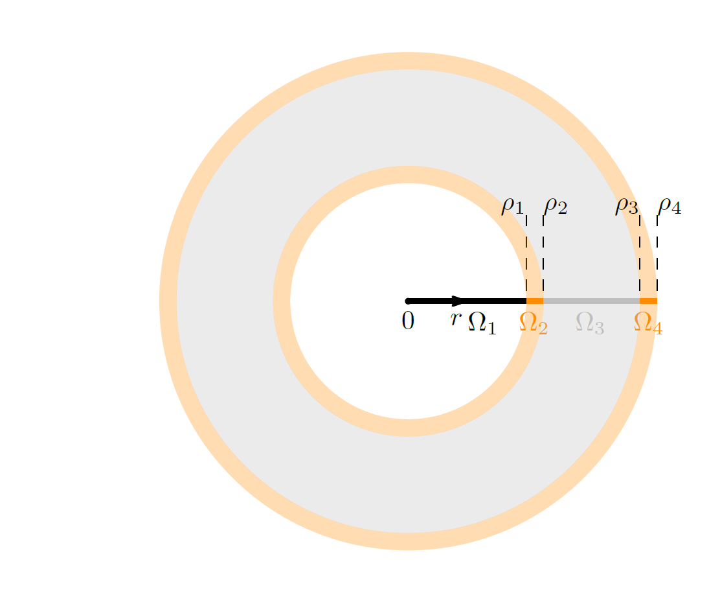
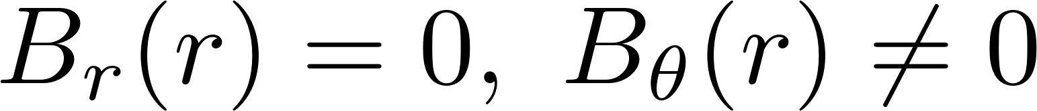
Example of a (physically relevant) 1D, 2nd order BVP
Model reduction for a toroidal inductor
Axial length larger than outer radius:
3D →2D cross-section
Assumption:
Uniform current distribution region instead of (ill-defined position of) individual wires
Toroidal symmetry in the magnetic field:
2D → 1D model with 4 regions in which
s

Slide 25
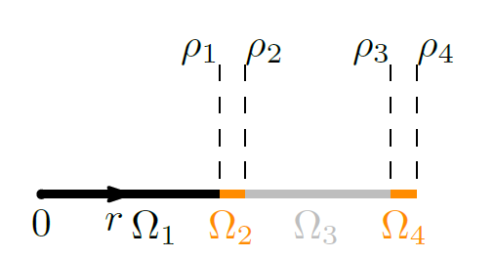
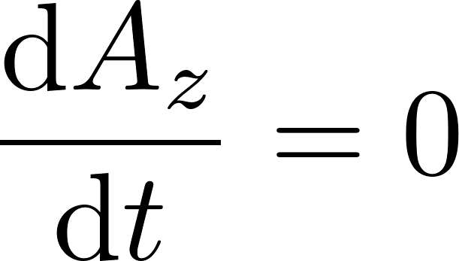
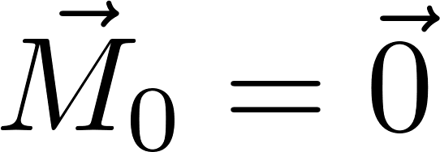
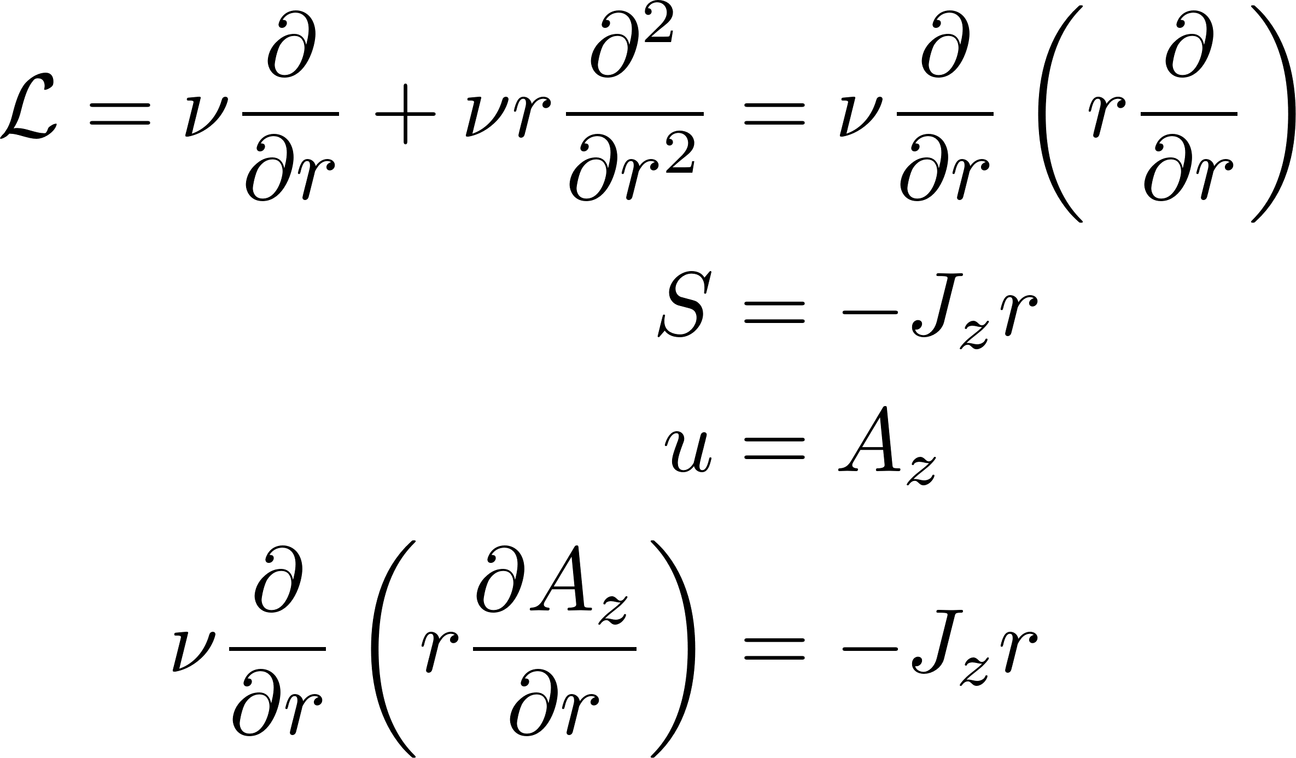
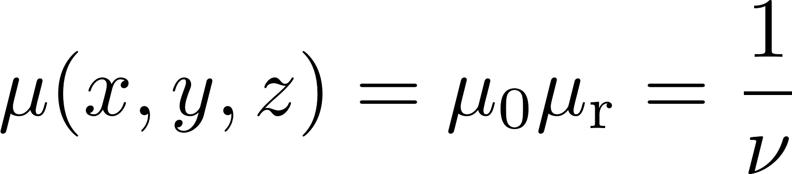
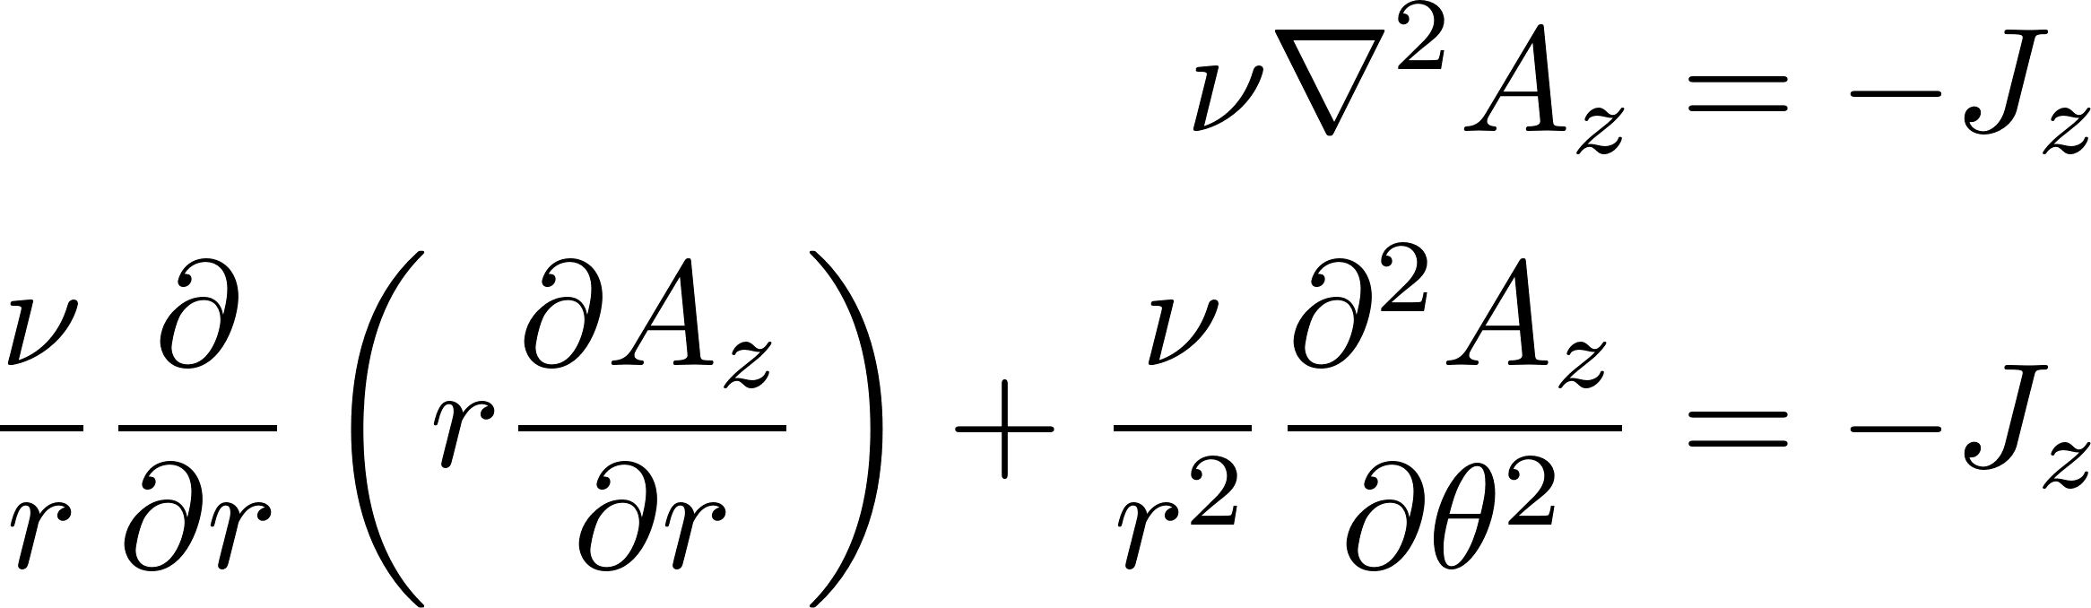

Generic solution of the linear magnetostatic BVP: toroid
Proper formulation of the PDE
Magnetostatic:
No permanent magnets:
Linear materials:
Governing PDE in polar coordinate system

Slide 26
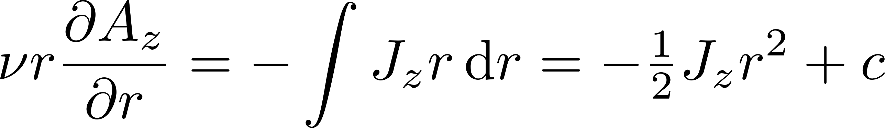
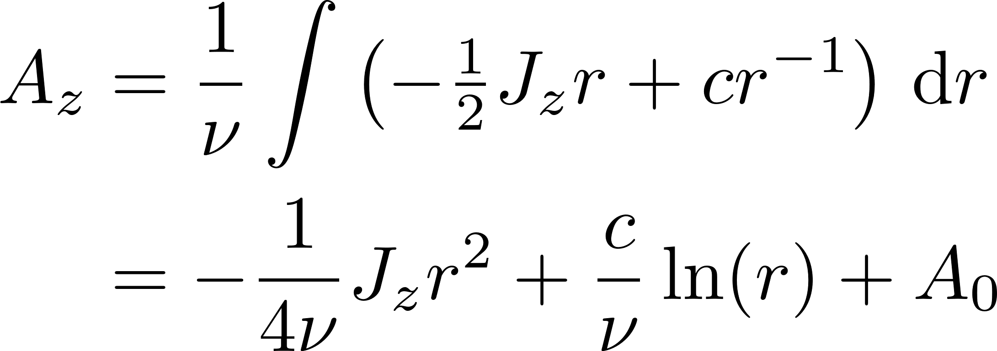
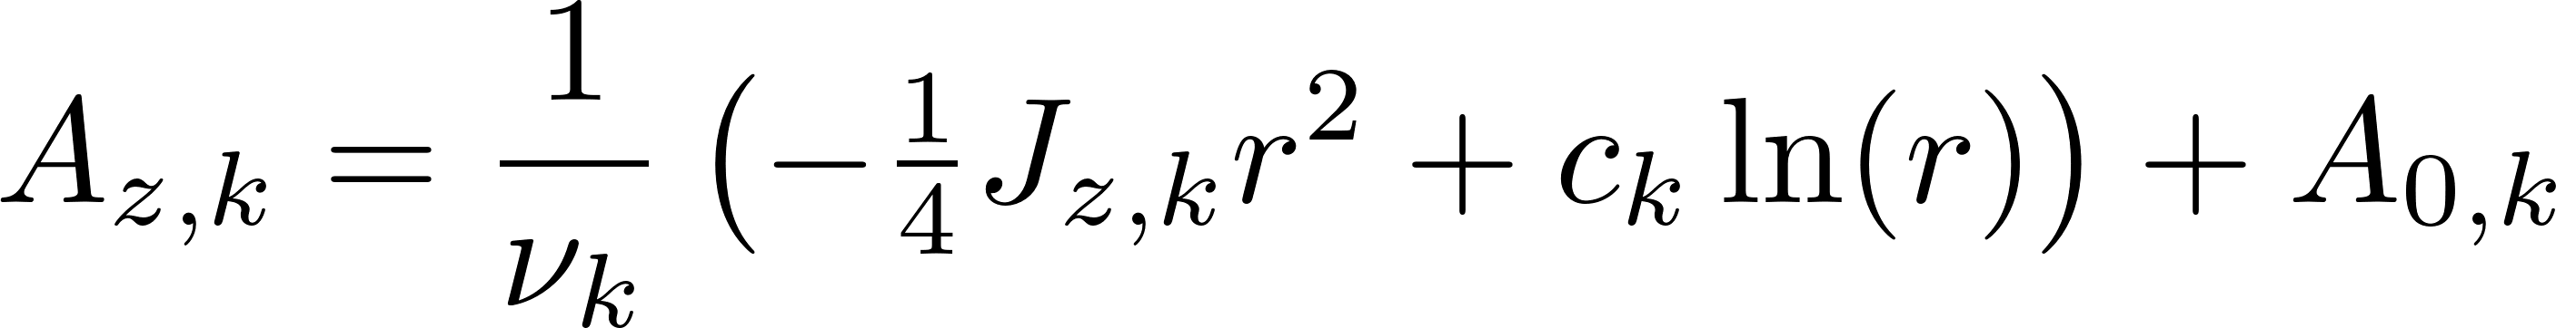
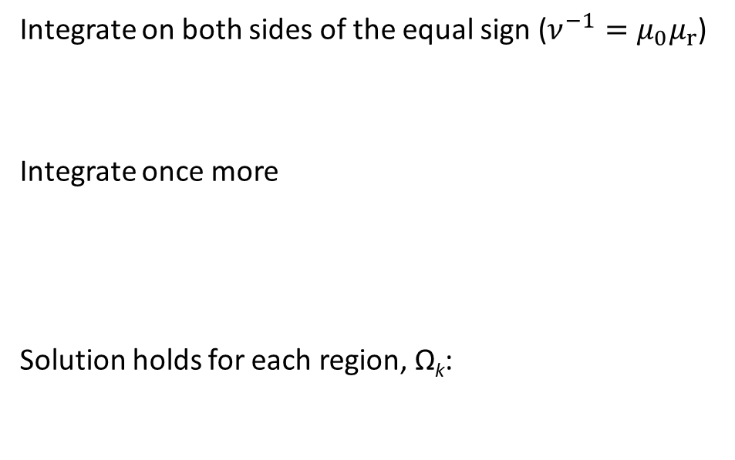
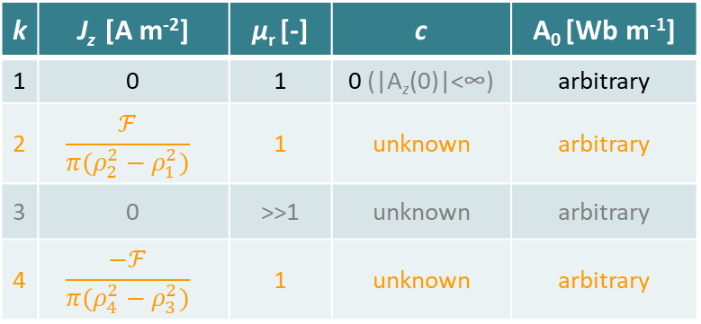
Generic solution of the linear magnetostatic BVP: toroid
Integrate on both sides of the equal sign ($ν^{−1}=μ_{0}μ_{r}$)
Integrate once more
Solution holds for each region, Ω_{k}:
k | J_{z} [A m⁻²] | µ_{r} [-] | c | A₀ [Wb m⁻¹]
1 | 0 | 1 | 0 (|A_{z}(0)|<∞) | arbitrary
2 | $$\frac{ℱ}{π(ρ_{2}^{2}−ρ_{1}^{2})}$$ | 1 | unknown | arbitrary
3 | 0 | >>1 | unknown | arbitrary
4 | $$\frac{−ℱ}{π(ρ_{4}^{2}−ρ_{3}^{2})}$$ | 1 | unknown | arbitrary
Notes:
Stress importance integration constant for the indefinite integral
F: magnetomotove force MMF → F=NI

Slide 27
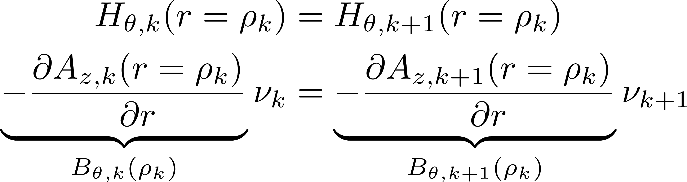
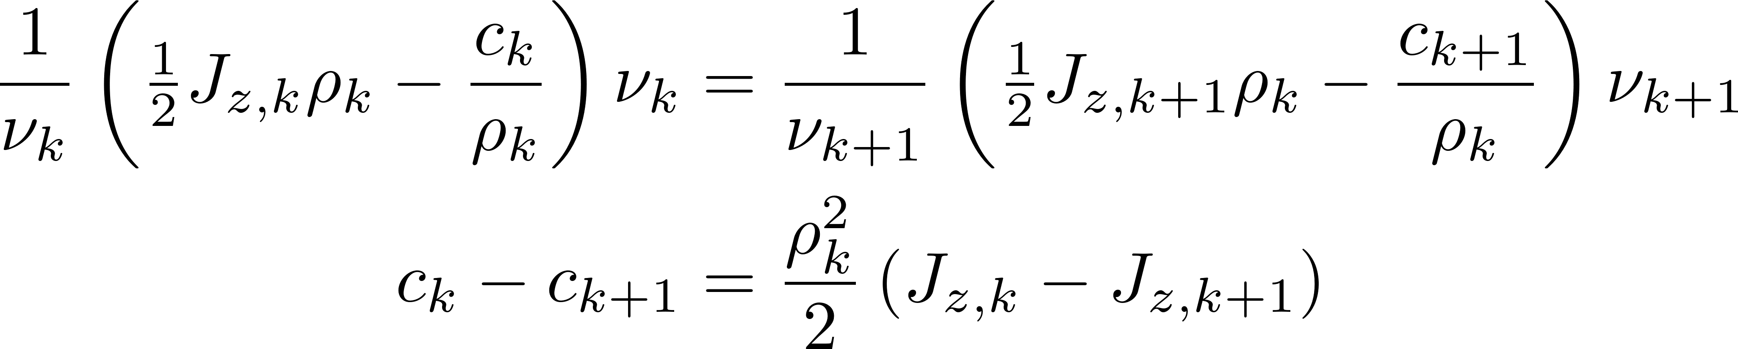
Unique solution of the linear magnetostatic BVP: toroid
3 Unknown constants, c_{k}, to be found via BCs, k∈ {1,2,3}
Substitution results in a system of linear equations:
Notes:
Material properties cancel for the H-fields

Slide 28



Unique solution of the linear magnetostatic BVP: toroid
Remaining constants, A_{0,k} , can all be chosen freely, as B_{k} is not affected by this choice!
Common to only choose one and require continuity, e.g.:

Slide 29

Unique solution of the linear magnetostatic BVP: toroid

Slide 30


Numerical methods for solving differential equations

Slide 31





Interpolating pairs of positions and corresponding values
A known finite, discrete set of length $N$ of pairs of position and field-value in 1D
$u\left(ξ\right)$: $ξ∉\left[x_{1}, x_{N}\right]$via polynomial interpolation based on nodal information
$φ_{n}$ is a polynomial of order $P$ expressed in terms of all nodal positions
$φ$: basis function

Slide 32








Local interpolation within elements (subdomains )
Simple ‘local’ interpolation in an element: $Ω_{e}=\left\{x_{Pe−P+1}, …,x_{Pe+1}\right\} :1≤e≤E$
Piecewise : value depends only on the element spanned by $P+1$ nodes, in which it lies
$C0$-contuinuity : only require continuity of $u$ between adjacent elements, not of its derivative(s)
$\left\{x_{n}:\frac{n−1}{P}∈ℤ^{+},n<N\right\}$ is the set of coinciding end-nodes of elements: ${ξ_{e,P+1}=ξ}_{e+1,1}=x_{n}$
$Ψ$: shape function
Notes:
Z⁺: All positive integers

Slide 33




Choice for the shape functions: Lagrange polynomials
The choice of the order $P$ and number of elements $E$ affect:
$N=EP+1$ : Total number of nodes, where $E∈ℤ^{+}$ (nonzero, positive integer)
$E\left(P+1\right)$ : The total number of shape functions
$e∈ℤ^{+}:e≤E$ : element index
No division by zero as $k≠p$ excludes a zero-valued denominator from the product, where
Notes:
PI-notation products

Slide 34







Properties of the Lagrange polynomials
Only nonzero in its respective subdomain and
Zero on all nodes $x_{n}$ but one: at the nonzero node equal to one
$u(x)$ is the sum of scaled shape functions; scaling factor is the nodal value $u_{n}\text{ : }Ψ\left(x_{n}\right)≠0$
More shape functions than nodes: $E\left(P+1\right)>EP+1:\left\{E,P\right\}∈ℤ^{+}$
Shape functions nonzero at the same end-node are both scaled by the corresponding nodal value

Slide 35

Relevance of interpolation
The set of nodal field-values, $un$, are not known in advance, but actually are the ones that need to be calculated, such that:
They satisfy the governing partial differential equation (PDE)
Respect the physical boundary conditions
Can a ‘reverse’ method be formulated that allows the discrete nodal field distribution to be calculated once a proper interpolation is chosen?
YES!
By reformulating the governing PDE as a weak formulation

Slide 36




The weak formulation of a PDE
The weak formulation of a PDE relaxes requirements:
From local to global requirements by transforming to a weighted integral equation
Reducing continuity requirements by reducing the order via integration by parts.
The weak formulation can be obtained via the method of weighted residuals
Strong formulation (analytical)
Weak formulation (numerical)
residual (ε)
weighting function ($≠0$)
Notes:
Goal: transform the PDE to a system of equations

Slide 37





Relaxing the order to obtain the weak form
Applying integration by parts to
Integration by parts:
Observations:
The order of the PDE is reduced by ‘shifting’ it from $ℒu$ to $w$ via $v′\left(u\right)→v\left(u\right)$
Information on the field at the boundaries $\left\{x1,xN\right\}$ is required
Notes:
Stress boundary term
Different signs for natural BC

Slide 38





The problem specific weak form of the PDE
Substitution of the problem specific expressions with$J_{z}=J$
Substitution of the approximation/interpolation with basis functions
Weak form:
Notes:
Curl of MVP: B=-dA/dr

Slide 39







Defining the weighting function
The problem specific weak formulation
weighting function, $w$, not yet defined
a single equation with $N$ unknows → solvable via the choice of (a set of) weighting function, $w$
The choice for $w$ determines the class of the Finite Element Method (FEM)
Method | $$εw$$ | Principle
Least squares |  | $∇$-operator optimizes the residual in the least squares sense by taking the gradient of the squared residual w.r.t. all $N$ nodal values, $u_{n}$
Method | $$εw$$ | Principle
Least squares |  | $∇$-operator optimizes the residual in the least squares sense by taking the gradient of the squared residual w.r.t. all $N$ nodal values, $u_{n}$
Collocation |  | Residual zero on each node by multiplication of a set(!) of $N$ $δ$-function to obtain $N$ equations (sifting property of the $δ$-function)
Method | $$εw$$ | Principle
Least squares |  | $∇$-operator optimizes the residual in the least squares sense by taking the gradient of the squared residual w.r.t. all $N$ nodal values, $u_{n}$
Collocation |  | Residual zero on each node by multiplication of a set(!) of $N$ $δ$-function to obtain $N$ equations (sifting property of the $δ$-function)
Galerkin |  | A set(!) of $N$ weighting functions equal to the set of $N$ basis functions to obtain $N$ equations

Slide 40





Problem specific weak form: Galerkin method
Weak form:
Stiffness matrix: $K$ Load vector: $\vec{F}$
Natural (Neumann) boundary condition!
Notes:
Each entry integration over full domain
Summation → Matrix equation

Slide 41




Problem specific weak form: integration per element
Weak form:
For load vector ${\vec{F}}_{e}$, the limits of the integrals are also replaced by the respective begin- and end-nodes of the $eth$ element: ${ξ_{e,1}=r}_{\left(e−1\right)P+1}$ and ${ξ_{e,1}+L_{e}=r}_{eP+1}$
Notes:
Split up integration from full domain to sum of subdomains
xi_{e,1} first node

Slide 42





Problem specific weak form: meshing the domain
Dividing the spatial domain into elements
Identification of regions with different physical properties in terms of materials and sources
Meshing of each region into elements by creation of end-nodes (respect physical boundaries)
Addition of internal nodes within each element when $P>1$
↓↓↓ Toroidal inductor ↓↓↓
hole coil side (+) soft-magnetic core coil side (-)
Notes:
Combine many low-order local fits instead one fit for the full domain: meshing

Slide 43




Problem specific weak form: matrix construction
For integration on the element level substitute: $φ→Ψ$
$Ψ_{m,p}=0: m≠e$ → $K_{e,ij}≠0 ∀ \left\{i,j\right\}∈[\left(e−1\right)P+1, eP+1]$
Only a ‘small’ symmetric ${\left[P+1\right]}^{2}$ submatrix is nonzero in $K_{e}$
Similarly for the load vector: $m≠e$ → $F_{e,i}≠0 ∀ i∈[\left(e−1\right)P+1, eP+1]$
Notes:
Shape functions zero outside e-th element
Submatrices on the diagonal of the stiffness matrix

Slide 44
























Problem specific weak form: matrix construction
$${\left\{i,j\right\}}_{1}∈[1, P+1]$$
$$+$$
$${\vec{F}}_{1}$$
$$0$$
$$M_{1}$$
$$+$$
$${\left\{i,j\right\}}_{2}∈[P+1, 2P+1]$$
$$+$$
$${\vec{F}}_{2}$$
$$M_{2}$$
$$+$$
$${\left\{i,j\right\}}_{3}∈[2P+1, 3P+1]$$
$${\vec{F}}_{3}$$
$$M_{3}$$
$${\left\{i,j\right\}}_{E−1}∈[(E−2)P+1, (E−1)P+1]$$
$$0$$
$$M_{E−1}$$
$$+$$
$${\vec{F}}_{E−1}$$
$$+$$
$${\left\{i,j\right\}}_{E} ∈[(E−1)P+1, EP+1]$$
$$M_{E}$$
$${\vec{F}}_{E}$$
Notes:
Construction of the stiffness matrix from submatrices; and load vector from subvectors

Slide 45




Matrix entries (uniform nodal distribution in elements)
Shape functions for an element of length $Le$= $r_{\left(e−1\right)P+1}−r_{\left(e−1\right)P+P+1}$
Example for polynomial of order $P=2$
Product rule:
$${\left(fgh\right)}^{′}=ghf^{′}+fhg′+fgh′$$

Slide 46




Stiffness submatrix entries (uniform nodal distribution)
Evaluating the integrals for the stiffness submatrix
$Ma$ and $Mb$ are both of size ${\left[P+1\right]}^{2}$ and only contain constants
Notes:
Ma and Mb do not change. Same for ALL elements

Slide 47





Load subvector entries (uniform nodal distribution)
Evaluating the integrals for the load subvector
$\vec{F}a$, $\vec{F}b$ and $\vec{v}bc$ all have size $\left[\left(P+1\right)×1\right]$ and only contain constants
Only nonzero for
$e=E$ and $i=P+1$
Notes:
Explain delta function

Slide 48


Dealing with boundary conditions
Nodes at extremities of an element adjacent to other elements
Continuity of the MVP automatically ensured, no requirement on natural BCs
Any node at the extremities of the domain with Neumann BC (imposed field vector)
Include and evaluate the natural boundary condition term accordingly for $e∈\left\{1,E\right\}$
Any node at the extremities of the domain with Dirichlet BC (imposed MVP)
No requirement on the flux density for $e∈\left\{1,E\right\}$ $→$ natural BC term ignored ($B_{θ}=0$)

Slide 49



Dealing with essential (Dirichlet) boundary conditions
A subset of nodal values on the boundary of the domain are known in advance
In 1D only nodal values $A1$ and $AE$ are affected: $A1=a$ and $AE=b$
Only columns 1 and E of $K$ operate on $A1$ and $AE$
Move all known values to the load-vector side of the equal sign
Only $M1$ and $ME$are affected: when constructing $K$ (only nonzero contribution in ‘corners’)
All entries in the load vector, $\vec{F}$, seem to be affected, but similarly only $\vec{F}1$ and $\vec{F}E$ will be

Slide 50











Dealing with boundary conditions
Stiffness-submatrices for 2nd order elements, $P=2$
 |  | Natural BC (Neumann) |  | Essential BC (Dirichlet)
 | $$e≠\left\{1,E\right\}$$ | $$H_{θ}\left(r_{1}\right)=α$$ $e=1$ | $$H_{θ}\left(r_{E}\right)=β$$ $e=E$ | $$A\left(r1\right)=a \\ e=1$$ | $$A\left(rE\right)=b$$ $e=E$

Slide 51
















Dealing with boundary conditions
Load-subvectors for 2nd order elements, $P=2$ (Either BC-type applies for a node!!)
 |  | Natural BC (Neumann) |  | Essential BC (Dirichlet)
 | $$e≠\left\{1,E\right\}$$ | $$H_{θ}\left(r_{1}\right)=α$$ $e=1$ | $$H_{θ}\left(r_{E}\right)=β$$ $e=E$ | $$A\left(r1\right)=a \\ e=1$$ | $$A\left(rE\right)=b$$ $e=E$
Notes:
Sign difference in natural BC due to BC term difference after partial integration

Slide 52

Numeric vs. analytic solution: same mesh, different orders
Mesh
Notes:
STRESS: 20x!!!!!!!

Slide 53


Implementation in Matlab
Notes:
Remark on evaluation of integrals for arbitrary order in MatVecConstant beyond scope:
Subroutine available

